Slide 1

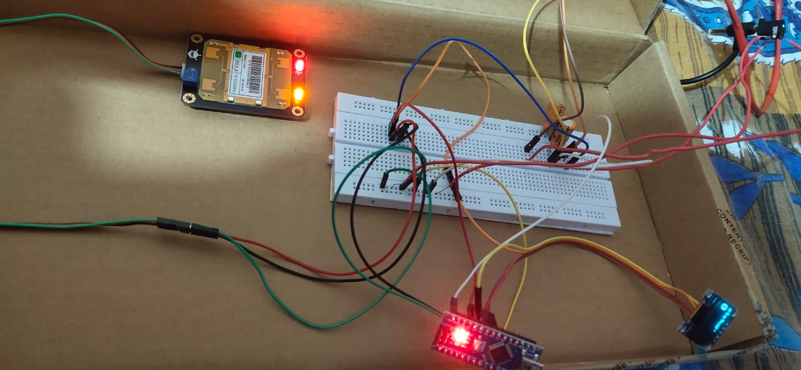
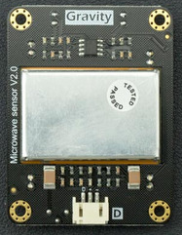
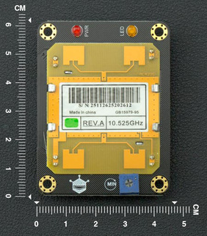
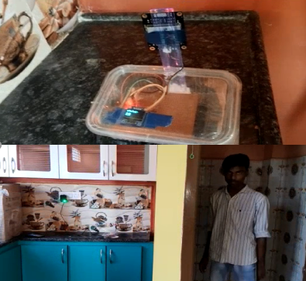
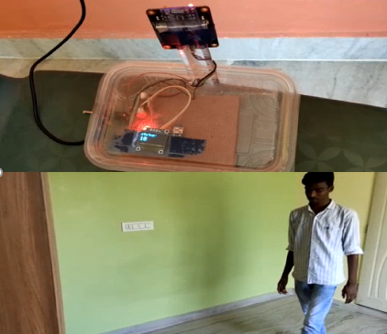
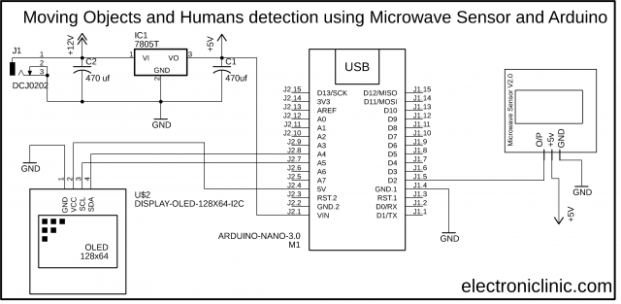
Microwave Sensor with Arduino for humans and objects detection behind walls
GROUP MEMBERS: 1. Dhruva Rakesh B – 19BES7003 GUIDE : Prof. BHARATH REDDY GUDIBANDI SCHOOL : SENSE 2. Dulam Sai Varun Goud – 19BES7031 3. Venishetti Nithin – 19BES7038
Motivation/ Introduction
Results
We have used this digital Microwave Sensor with Arduino for moving humans and objects detection behind the walls. This digital microwave Sensor uses doppler radar to detect moving objects using microwaves.
The microwaves are sensitive to a variety of objects and the amazing thing is its sensor readings are not affected by ambient temperatures. So, that’s why, this type of sensor is widely used in industrial, transportation, and civil applications such as automatic lights control system, high level security systems, and so on.
The 12 V DC adapter is used to provide input power after the circuit is connected. The microwave sensor's antenna surface side must face the wall.
An OLED module will be used to display the results. It will be possible to detect the motion behind the wall and see the randomness of it as a number.
The status score will be lower if just very slight movement is found.
There is unquestionably a person or moving item there behind the wall if the status is significantly higher.
To evaluate the machine's performance, we used test cases. First, we have taken a thin wall that was 4 inches thick and extended it to 16 inches thick. Then we looked at what the OLED was producing. To provide Arudino with interruptions and gather the output, a person is randomly travelling to the opposite side of the wall.
A person is standing behind a wall of 16-inch thickness, and at the start he stood still, so there is no motion detected by the microwave sensor present on the other side of the wall. Hence, we can see there is no update in the status value.
If there is motion detected, then the status will be incremented and can be concluded as "moving person."
If the person goes out of range, then the status also will decrease.
Implementation:
SCOPE of the Project
A microwave sensor broadcasts a variety of microwaves at various frequencies toward a detection area, and then performs an object detection operation using the microwave waves that are reflected off an object that is present in the detection region.
The microwave sensor has a distance identification section for measuring the distance to an object in the detection area, a movement-distance identification section for measuring how far the object is moving over time in the detection area, and an object determination section that processes the output from the movement-distance identification section and to determine the object detection.
Methodology
Digital Microwave Sensor V2.0:
This is the Gravity Digital Microwave Sensor V2.0 from the DFrobot. This microwave sensor is able to detect objects without physical contact. Its readings are not affected by temperature, humidity, noise, air, dust, or light which makes it suitable for harsh environments. This sensor also has strong resistance to radio frequency interference. Due to it’s low output, it’s not harmful to the human body. Since this sensor uses microwaves and you know microwaves have a wide detection range and velocity equal to the speed of light. This digital microwave sensor also supports non-life-class object detection.
The Red color LED is the power LED and the Yellow color LED is the Signal Indicator LED. The indicator LED remains off, when there are no moving objects. The indicator LED will only turn ON when the sensor detects a moving object. The Yellow color PCB is the Antenna surface.
The red wire is the 5V, Black wire is the GND, and Green wire is the output wire. Now, let’s take a look at the circuit diagram of the automatic light control system using this Microwave Sensor.
Circuit Diagram:
PIN configuration:
The output pin of the microwave sensor is connected with the digital pin D2 of the Arduino while the +5v and GND pins are connected with the Arduino’s 5v and GND pins.
On the top left side is the regulated 5V power supply based on the LM7805 voltage regulator. J1 is the DC female power jack and this is where we connect a 12v adaptor, battery, or a solar panel.
The SCL and SDA pins of the Oled display module are connected with the A5 and A4 pins of the Arduino.
Conclusion/ Summary
As we know that Microwaves can penetrate through walls, so, we have used this digital microwave sensor for humans and objects detection behind the walls.
We have interfaced with this OLED display module for displaying the number of interrupts generated within 3 seconds. These interrupts are only generated when there are any moving objects or humans. So, a higher value means lots of movements. This microwave sensor has a distance range of 2 to 16 meters which can be adjusted using this blue colour potentiometer.
Contact Details
rakesh.19bes7003@vitap.ac.in
varun.19bes7031@vitap.ac.in
nithin.19bes7038@vitap.ac.in
Acknowledgments/ References
https://www.electroniclinic.com/microwave-sensor-with-arduino-for-humans-and-objects-detection-behind-walls/
https://www.youtube.com/watch?v=CyZRINdPuks
https://www.dfrobot.com/product-1403.html

